Slide 1
Microservices and DevOps
DevOps and Container Technology
Continuous Integration
Henrik Bærbak Christensen

Slide 2
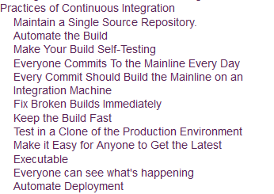
Fowler: Practices
CI requires a lot of practices to be in place…
[Fowler, 2006]
Premise:
Monolith focus…

Slide 3
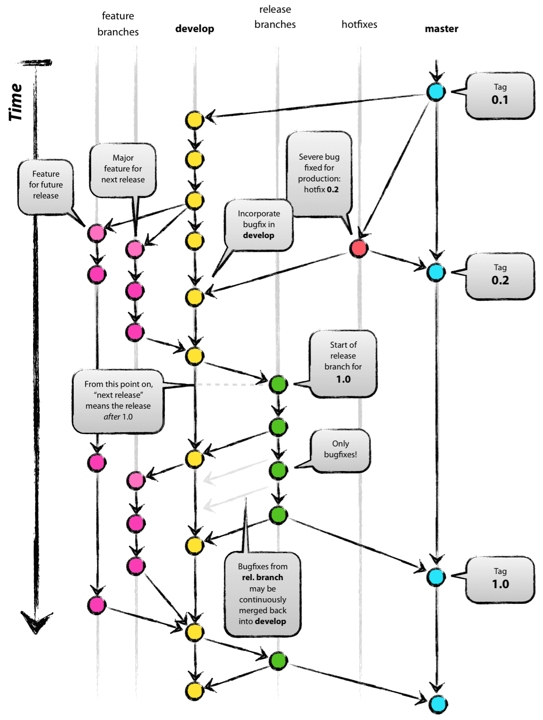
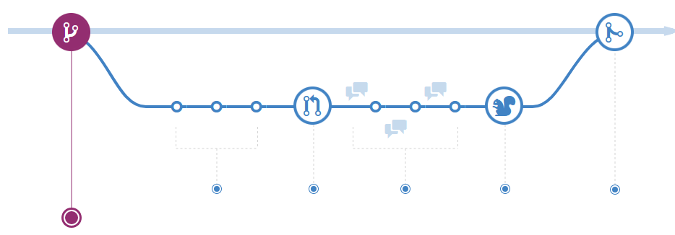
Maintain Single Repository
Use a strong software configuration management tool
Git, Subversion, …
Define a branching and release management strategy
Ex:
http://nvie.com/posts/a-successful-git-branching-model/
https://guides.github.com/introduction/flow/

Slide 4
Automate Build
Use a build tool
Gradle, Maven, Ant, …
Litmus test on New Machine
Check out source, issue a single command, and it should be running!
Does your SkyCave pass the litmus test?

Slide 5
Self-Testing Build
Make the build do
Compile, run (all) test suites, run
Built into the Test-Driven Development process…
Note
Run all unit test suites on every build on dev machine
But not the integration test suites that exercise the out-of-process tests. They are too slow
Use a CI approach to run all test suites that include the integration test suites

Slide 6
Commit to Master Every Day
‘High frequency’ is the ideal !
Commit to the integration/master branch frequently
Integration is communication and early feedback
Finding the integration defect today is better than tomorrow
In line with TDD principle
Take small steps!
GitHub Flow is a simple branch model supporting this

Slide 7
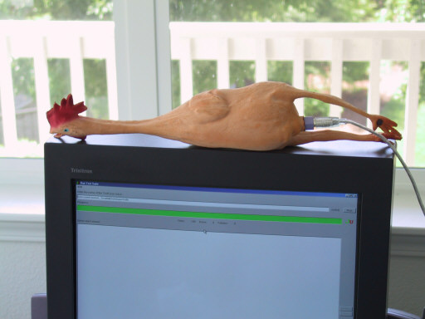
Every Commit is Integration
Every commit must trigger integration build on build server
But – commit to which branch?
Manually
Go to integration server; checkout out, and build (=test)
Continuous Integration Server
Dedicated software and machine
Bitbucket/Gitlab pipelines…

Slide 8
Fix Broken Builds Immediately
You must fix any integration defects immediately as they appear
Kent Beck: ”Nobody has a higher priority task than fixing the build”
In CI, you strive to have a deliverable product at all times!
One resort: Revert to last known good build…

Slide 9
Keep the Build Fast
Make the build fast, so defects are detected fast
What is fast? 10 minutes? One hour?
Warstory: The 15 minute full compile in the 1990’ies
Meant: you forgot why you started it!
Use pipelines and diverse test sets
Smoke testing Find obvious/big defects
Unit testing Much is stubbed (like DBs!)
Comprehensive testing Real DBs are started, filled, and tested
Two staged pipeline
First-stage: Just unit tests (“very fast=10min” ?);
Second-stage: Comprehensive (hours);

Slide 10
Test in Clone of Production Env
Make the test environment look like the production environment as much as possible
Same DBs, same version, same configuration, etc.
Not always possible
Consider NetFlix or Twitter ☺

Slide 11
Easy to Get Latest Executable
Every stakeholder must have access to latest product
Users, sales, developers, managers, …
Get feedback from the ones that will use it!

Slide 12
Everyone Can See What’s Happening
Make every change visible; everybody can see the current state
Alas: communication between stakeholders!
DashBoards on the integration server shows ‘what is happening’
Fowler warstory
Calendar with green/red square for ok/broken builds per day
Induce a common goal of ‘getting all the days green’

Slide 13
Automate Deployment
Make the deployment automatic so you can easily and quickly move executables between environments
Make scripts that does this movement fast, easy, and agile…
Today: Use IaC and tooling…
Again: Speed means we will do it!
Major driver for Docker…
Development Environment
Staging Environment
Production Environment

Slide 14
Discussion
CI means
Reduced risk
Increases awareness, visibility, of trouble spots
Increases confidence
Combats ‘Broken Windows Syndrome’
Liabilities
Tools suite in place
Training and habits must be in place

Slide 15
Discussion
CI does not require a build-server. It is a practice!

Slide 16
The Three Question
According to Jez Humble’s “Continuous Delivery”

Slide 17
Are we really doing it?

Slide 18
MicroService Take…

Slide 19
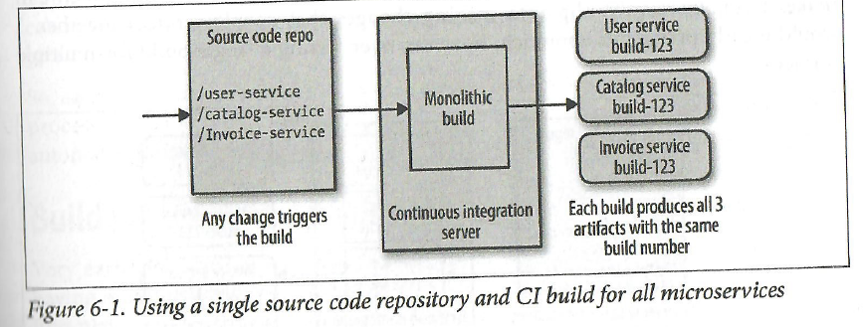
Single Source – Single Build
All services in one Repo, all build in one process
Benefits/liabilities?
Questions
Ownership?
Speed?
Broken builds?
What needs deploying?
Notes:
Pro: lockstep release; Con: Every change in one service triggers a slow and big process; and do all new services need to be deployed – hard to tell.
Any broken build stops everything. And who owns the build?

Slide 20
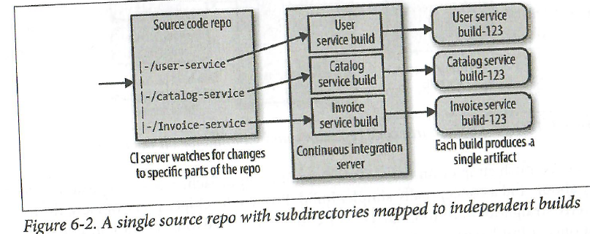
Single Source – Multi Build
All services in one repo, build per service
Benefits/liabilities?
Questions
Ownership?
Speed?
Broken builds?
What needs deploying?
Notes:
Shares some of the same liabilities as previous one.

Slide 21
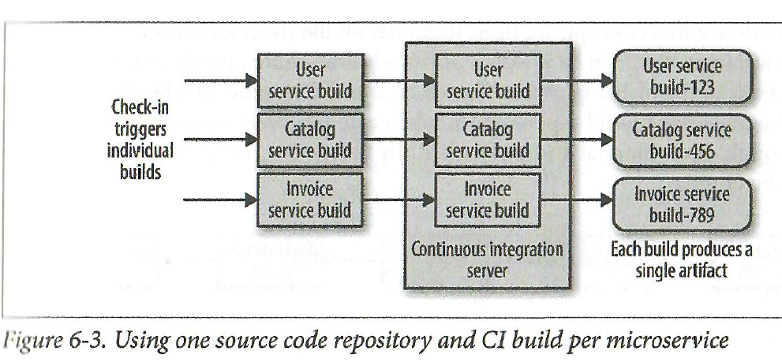
Multi Source – Multi Build
One service per repo, one build per service
Benefits/liabilities?
Questions
Ownership?
Speed?
Broken builds?
What needs deploying?
Notes:
Newmans favorite. Ownership is clear – source, pipeline, deployment rests in the team with no ‘crosstalking’. Con: if cross service changes must be made, creates more coordination. And what triggers the test journeys?

Slide 22
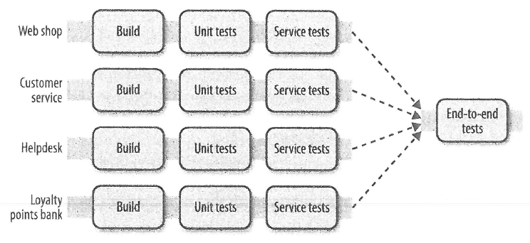
Test Journeys
Triggering the E2E tests / journeys is also a bit more involved…

Slide 23
Discussion
For completeness
Which model is missing?
Does this model have some virtue?
SkyCave is monolith, but…
Which model does is sort of lend itself to?
Notes:
Multiple services – single build. May actually detect integration defects. A depends on B, and B updates, A needs to rerun contract tests on B. SkyCave is near single source – single build

Slide 24
Summary

Slide 25
Summary
Microservices add some complexity
Single source – single build
Single source – multi build
Multi source – multi build
Multi source – single build (?)

